Slide 1

Extending Cordova with Plugins

Slide 2


Alex Casquete
Software Developer at Plain Concepts
acasquete@plainconcepts.com
@acasquete

Slide 3
Talking Points
Cordova Plugins JS API
Adding plugins
Available plugins
Extending a custom plugin

Slide 4


Cordova Plugins JS API
Native Wrapper
Cordova apps are web applications that run inside a native application.
Plugins provide a common JavaScript API to access device capabilities
A plugin is a cross-platform Cordova library that accesses native code and device capabilities through a JavaScript interface
<webview> Your JavaScript App
Cordova Plugin JS API

Slide 5
Cordova Plugins
All the main Cordova API features are implemented as plugins
Many others are available that enable features such as
bar code scanners,
NFC communication,
tailor calendar interfaces...
Registry of available plugins http://plugins.cordova.io/

Slide 6
Cordova Plugins
Single JavaScript interface
Corresponding native code libraries for each supported platform.
In essence this hides the various native code implementations behind a common JavaScript interface

Slide 7
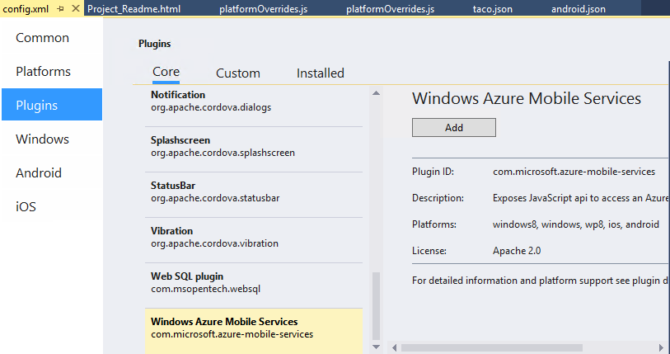
Adding a plugin
Use the Visual Studio configuration designer.

Slide 8
Cordova Plugins
The plugin also updates the platform manifest to enable device capabilities.
Not all plugins are supported or needed on all device platforms.

Slide 9
Configuring plugin parameters
After adding a plugin using the configuration designer, you can configure parameters by editing the config.xml file
<vs:plugin name="com.phonegap.plugins.facebookconnect" version="0.8.1">
<param name="APP_ID" value="12345678" />
<param name="APP_NAME" value="My Facebook App" />
</vs:plugin>

Slide 10
List of plugins available in the configuration designer
Accelerometer / Device Motion
Azure Mobile Services Client
Battery Status
Camera
Compass
Connection
Console
Contacts
Device
Dialogs / Notifications
File System
File Transfer
Geolocation
Globalization
InAppBrowser
Media
Media Capture
Splashscreen
Vibration
WebSQL Polyfill

Slide 11
Extending a custom plugin
At times, the custom plugins in the Cordova registry might not meet all your app requirements
You might want to extend a plugin or create your own plugin.
When
You need to offload computationally expensive functions to native code
Expose new device capabilities to your app.
Apply a fix to an existing plugin that you would prefer not to release publicly.

Slide 12
Demo Plugins
.

Slide 13
Questions?

Slide 14
Alex Casquete
Software Developer at Plain Concepts
acasquete@plainconcepts.com
@acasquete

Slide 16
Related Resources
Microsoft Azure Trial
http://azure.microsoft.com/en-us/pricing/free-trial/
Big Compute: HPC & Batch
http://azure.microsoft.com/en-us/solutions/big-compute/
Azure Batch Overview
http://azure.microsoft.com/en-us/services/batch/

